Slide 1

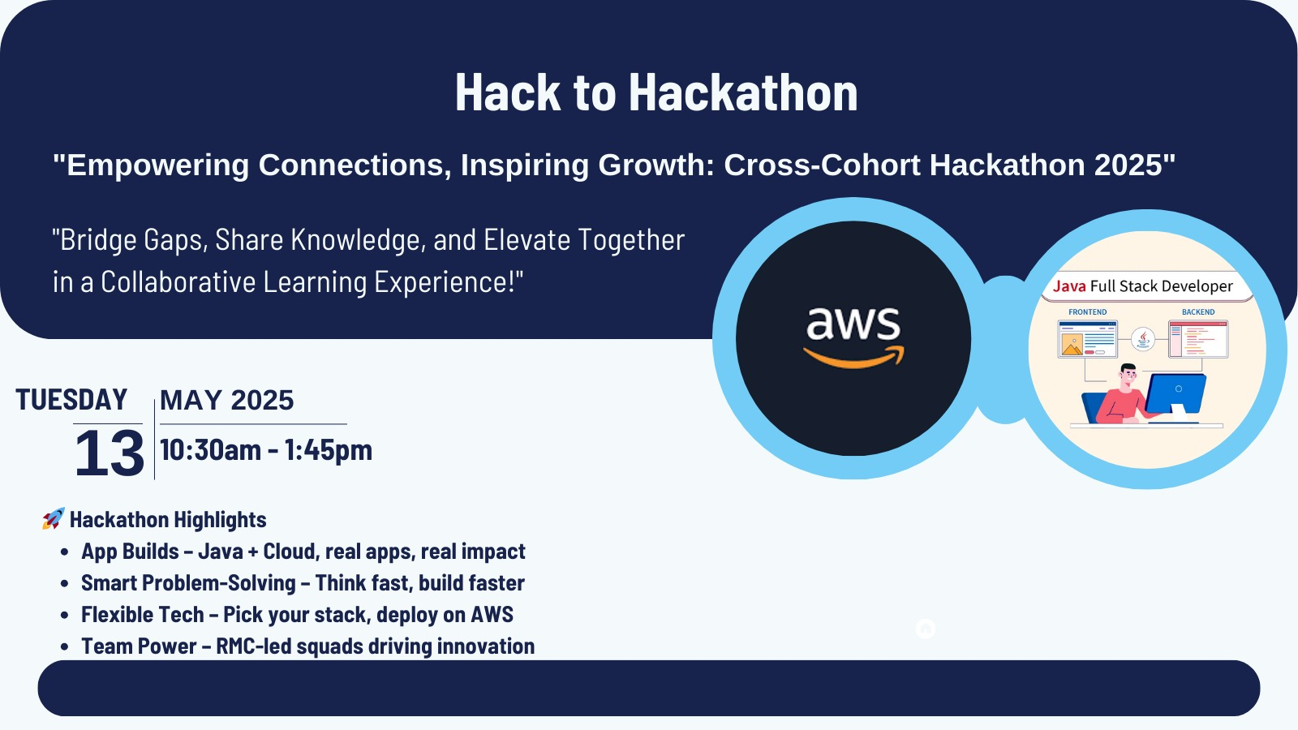

Slide 2
Project Topic
E-commerce Product Page

Slide 3
Project Team
Team Name : Hack Masters - Team 3
Team Lead : Adrina Colaco (RMC), Prathyusha K (RMC)
Mentor : Sandhya Gaikwad
Team Members :
Amar Karande | Anushka Sadanand Chaudhari
Ebrahim | Darshan Vijay Chaudhari
Jaee Joshi | Hitesh sharma
Samruddhi Jagdale | Yash Sanjay Ambarte

Slide 4
Project Overview
The E-commerce Product Page project is a static web page built using HTML, CSS, and JavaScript. This page is hosted on AWS Cloud in the S3 Service. The page showcases a product with detailed information, interactive features, and a user-friendly interface. The primary goal of the project is to present product details in an aesthetically pleasing and functional manner.

Slide 5
Objectives
Create a visually appealing product page
Implement interactive features like image zoom and a quantity selector
Ensure responsiveness for different screen sizes like mobile and desktop views
Product image gallery with thumbnail navigation
Detailed product description and specifications
Price display and “Add to Cart” functionality
Filtration based on product keywords, categories, and sizes
Static website hosting using AWS S3

Slide 6
Technical Stack
HTML: Structure and content of the web page.
CSS: Styling and layout for the page elements.
JavaScript: Adding interactivity and dynamic behavior.
AWS: Static website hosting using S3 bucket

Slide 7
Step-by-Step Development
Setting up the project structure (HTML, CSS, JS files)
Designing the product page layout using HTML
Applying styles and responsive features using CSS
Adding interactive elements with JavaScript (e.g., image zoom, cart update)
Testing and debugging for cross-browser compatibility.
Hosting the static website on AWS Cloud using an S3 bucket
Final Validations in the production environment

Slide 8
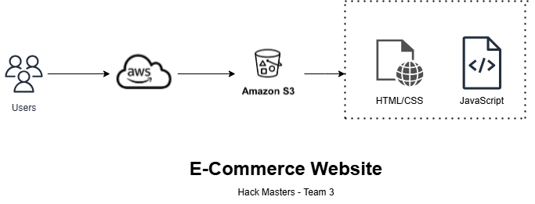
Architecture

Slide 9
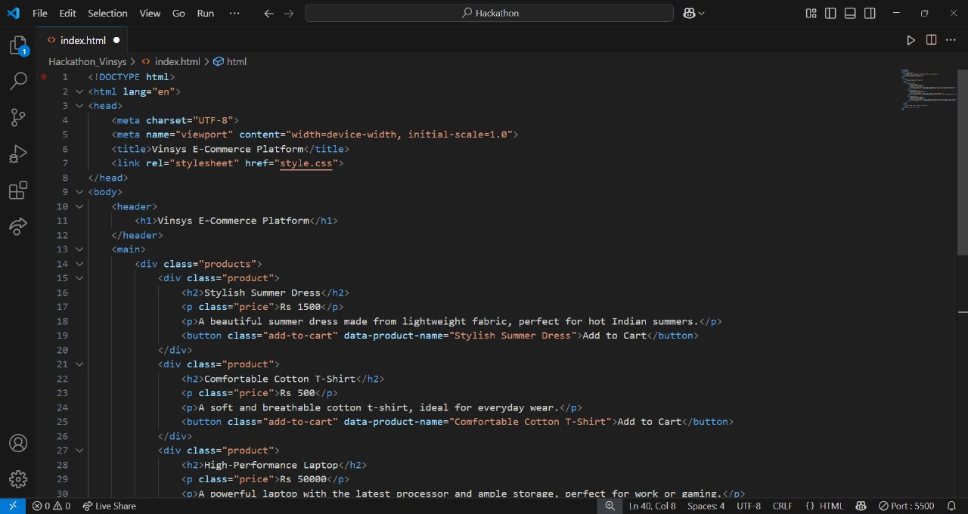
PROJECT DEVELOPMENT
Front-End Development:
index.html

Slide 10
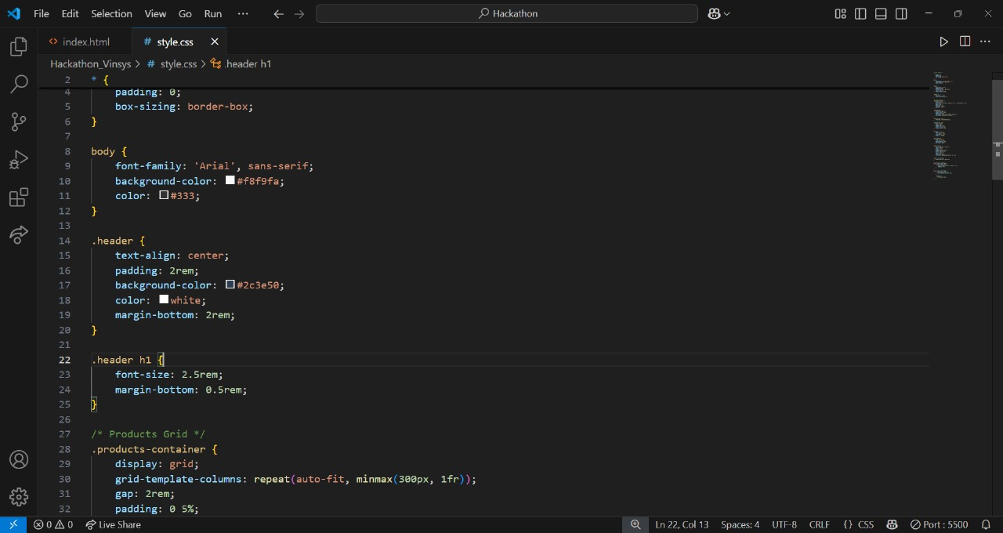
style.css

Slide 11
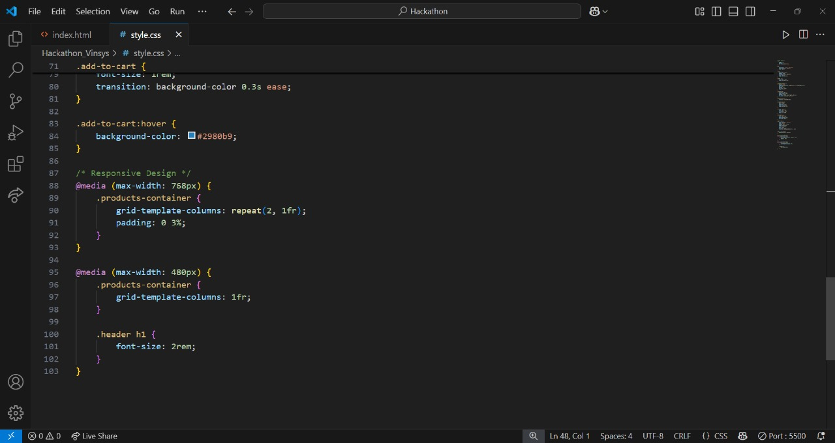
Frontend Part
style.css (cont)

Slide 12
JavaScript Features (script.js)
Cart Functionality:
Initializes an empty cart array.
Uses event listeners to add products to the cart.
Displays a message when a product is added.
Filter Functionality:
Captures search keywords, category, min price, and max price from user inputs.
Filters products based on these criteria.
Dynamically updates the product list.
User Interaction:
Instant feedback when adding a product.
Seamless filtering for a smooth user experience.

Slide 13
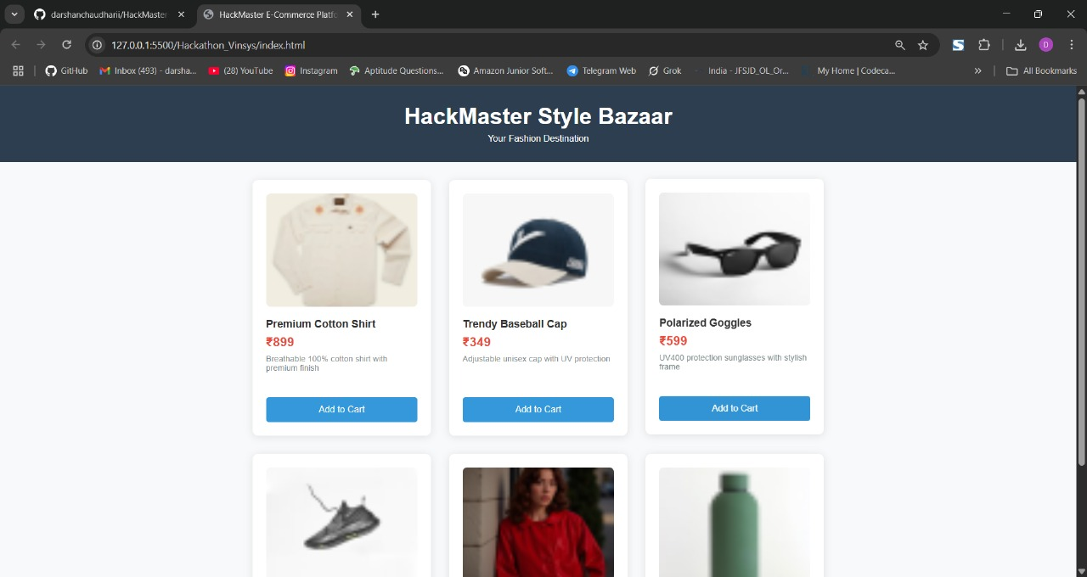
Web Page
Website

Slide 14
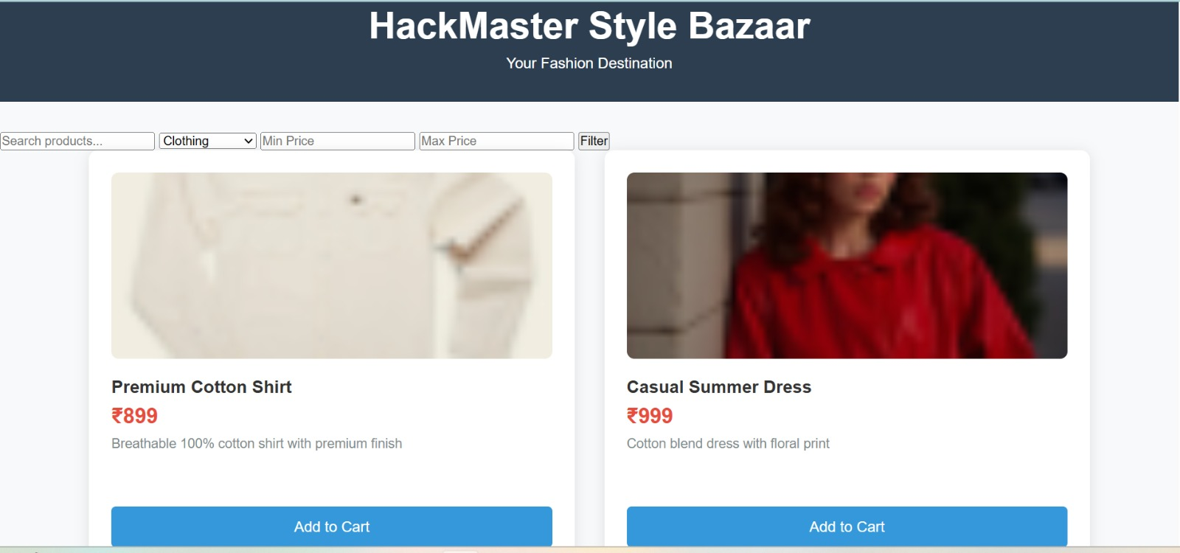
Added Categories and Filters

Slide 15
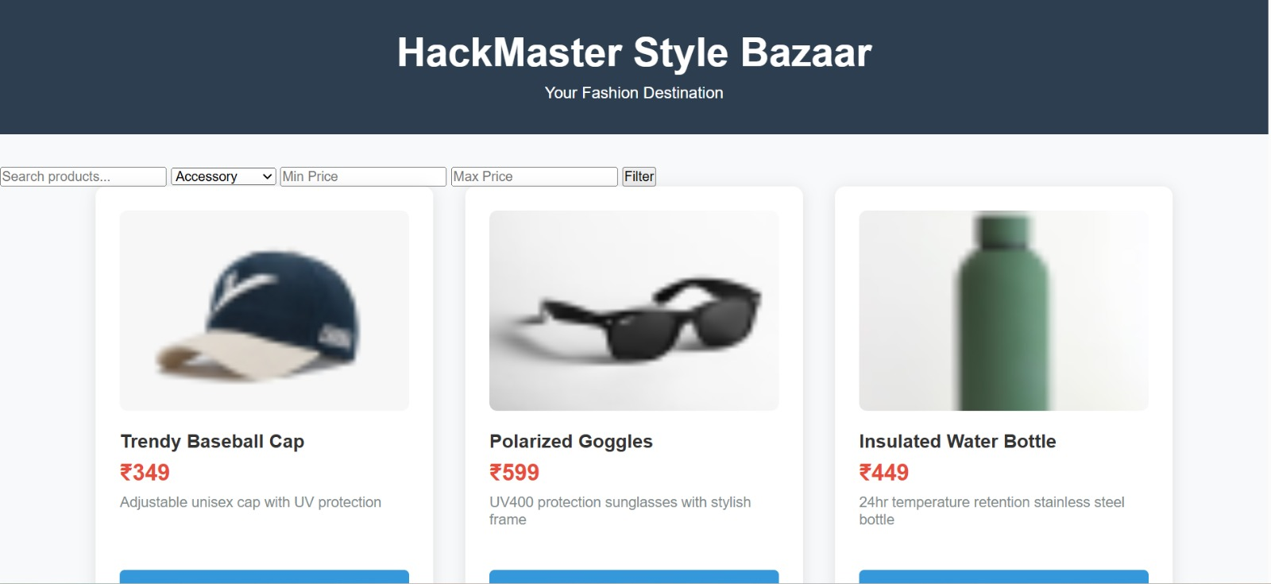
Accessories

Slide 16
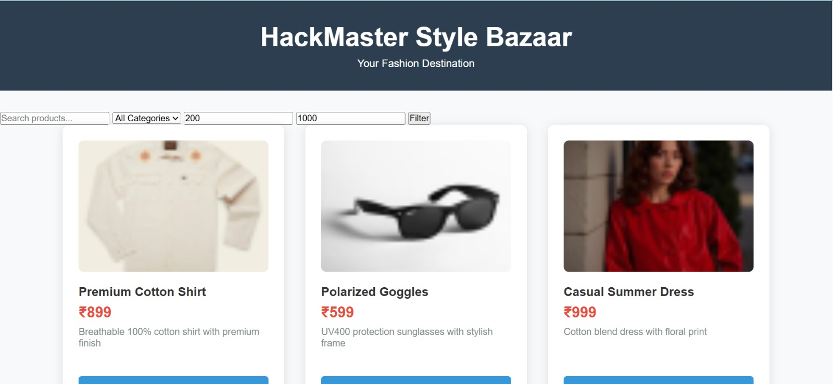
Prices

Slide 17
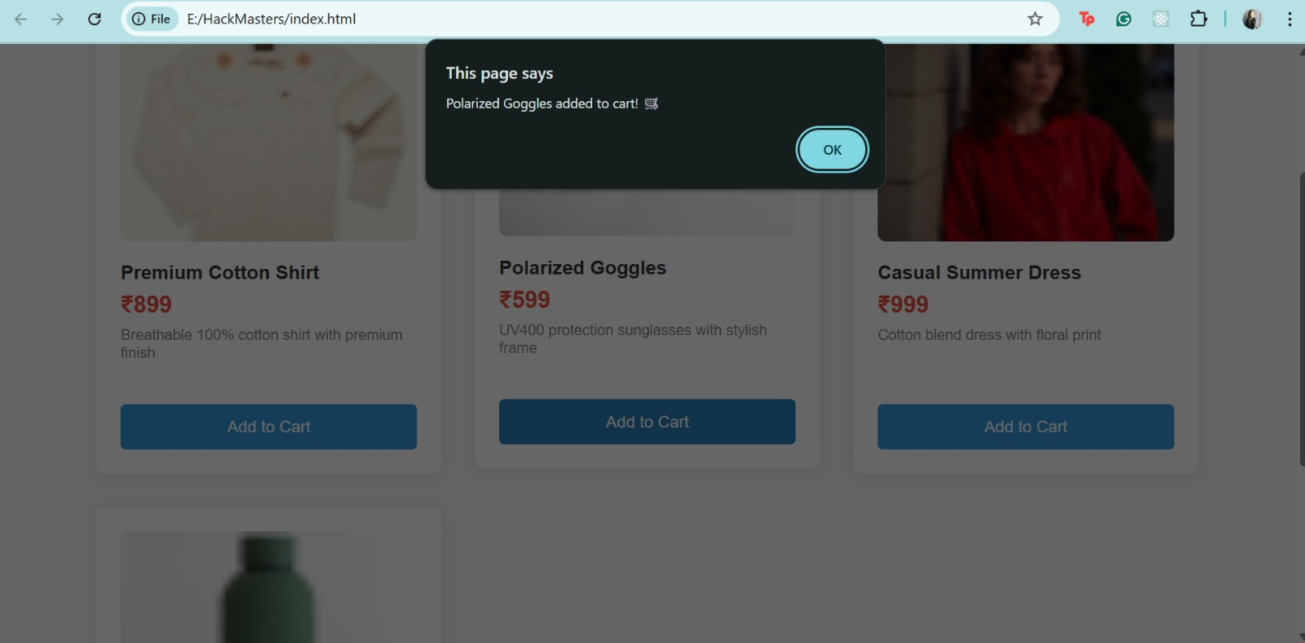
Added to Cart

Slide 18
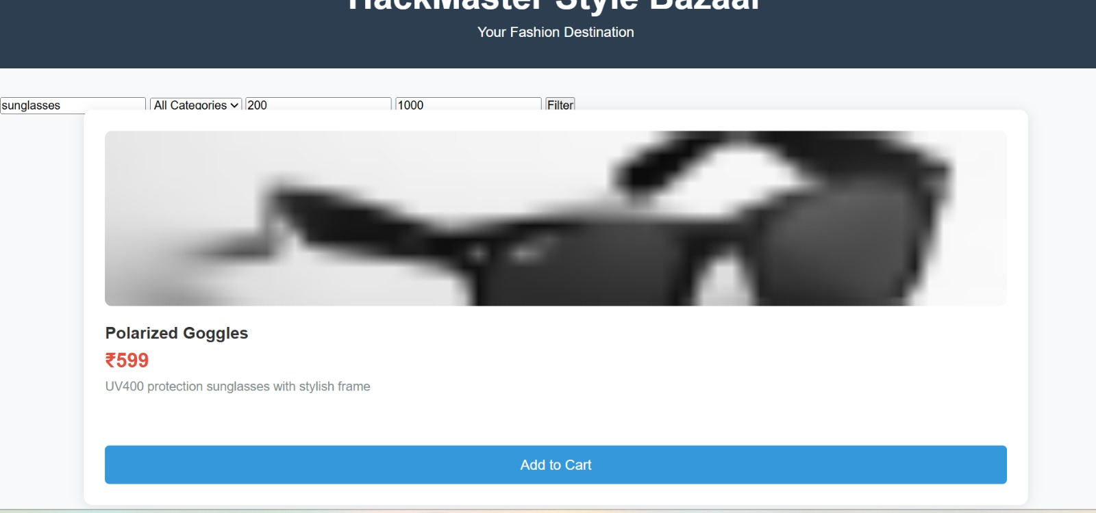
Search Box

Slide 19
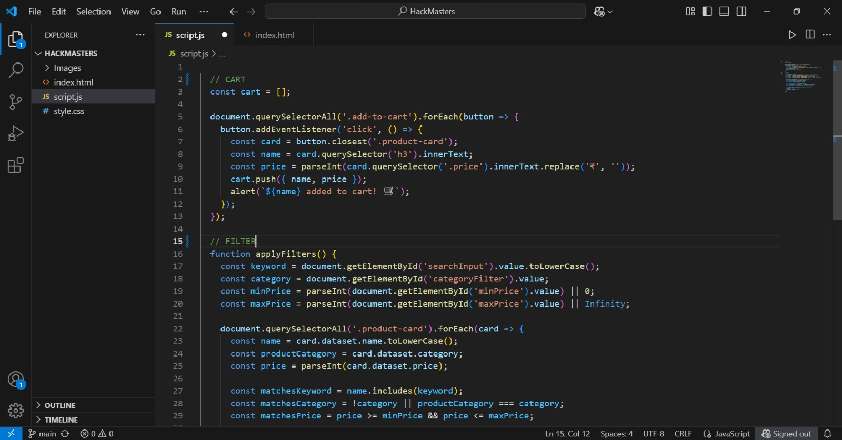
script.js

Slide 20
Project Deployment using S3
Creating the S3 Bucket
Service tab → Storage → Select S3
Create bucket → Give a unique name → Create bucket
Select bucket name → Upload → Add files → Browse project files, select and open them → Upload → Close the window

Slide 21
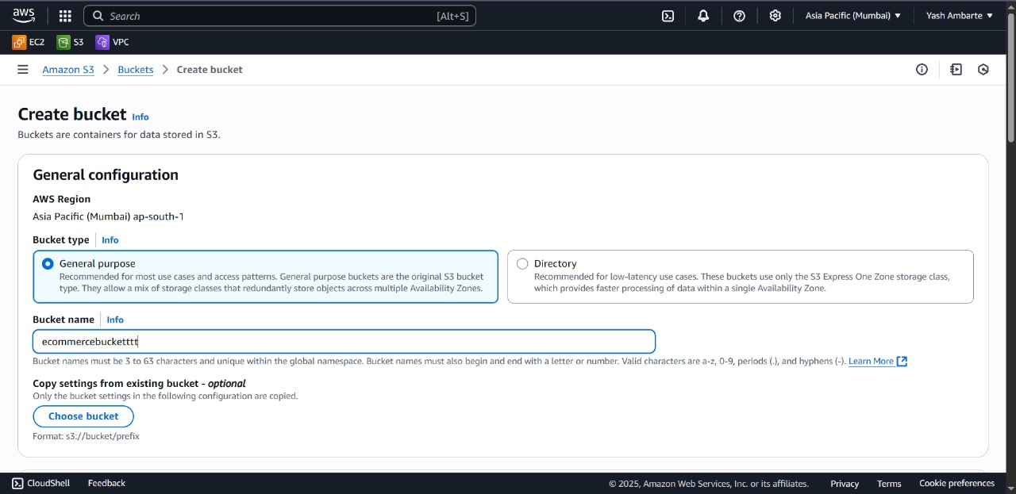
Create Bucket

Slide 22
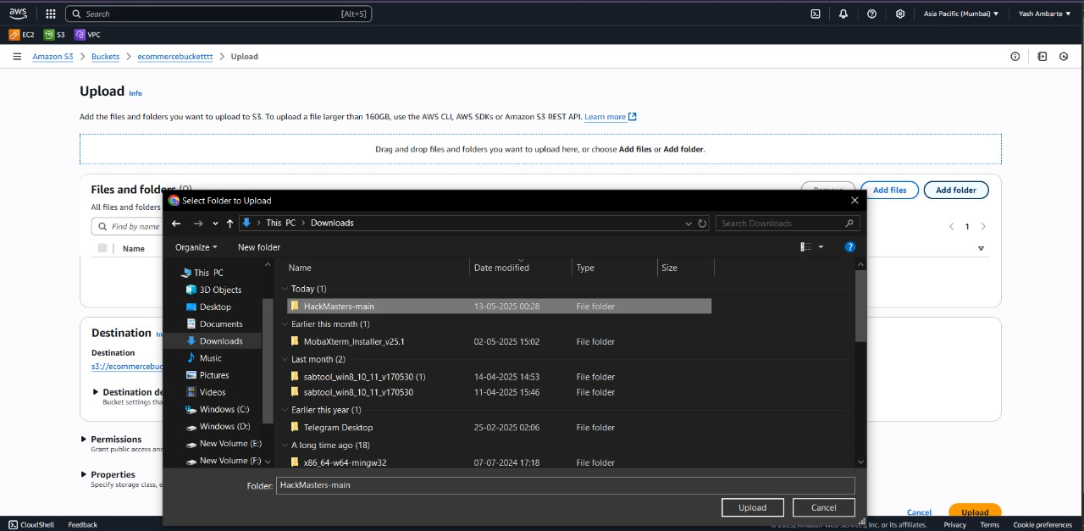
Upload Files to the bucket

Slide 23
Editing Bucket Policies
Edit bucket policies → Click on generate policies → Policy generator
Select S3 bucket policies, which will open a new window.
principals = * → actions = getobject → For arn = goto console and copy paste the arn → Add statement
Click on generate policies → copy the JSON code
Paste the copied JSON code in the bucket policy textbox->save changes
It will show an error, then edit the resource value, add /* in the end within quotes-> save changes

Slide 24
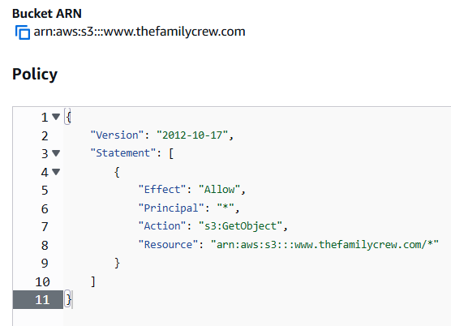
Updating Bucket Policies

Slide 25
Enabling Static Website
Go to property-> enable static website, fill index. HTML and error. HTML in the text field, and save
Copy the URL from the page's bottom and paste it in the browser’s tab
It will not show any HTML page because we have selected the block public access, which means the website is not accessible to the public, and the bucket objects are private by default.
Click on the bucket name ->permission->edit the block public access->unselect the block public access->save changes

Slide 26
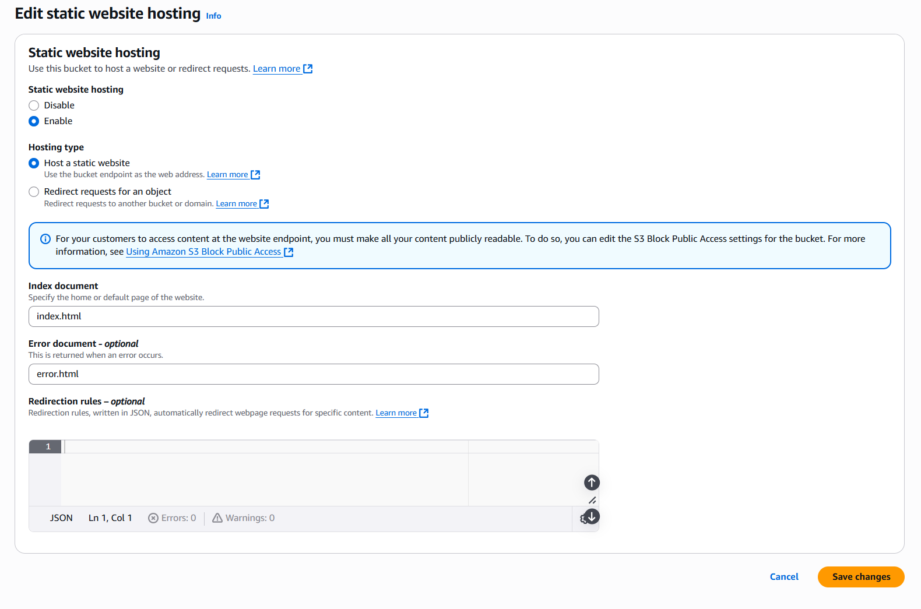
Enabling Static Website

Slide 27
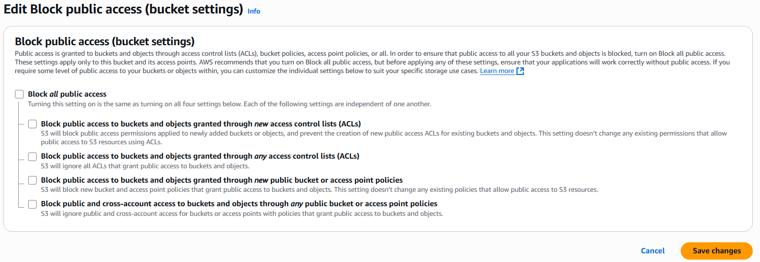
Uncheck Block Public Access

Slide 28
Web Page
Final Website Link http://e-commerce-websitehack-master3.s3-website-us-east-1.amazonaws.com/

Slide 29
Takeaways
Key Challenges:
Coordination within teams for GitHub
Assigning meaningful work when tasks are limited
Learnings:
Time Management
How to make the most of all resources.

Slide 30
THANK YOU!
By
Team 3 - Hack Masters

